Slide 1
EPA FUEL ECONOMY
Okwudili Ikejiani

Slide 2
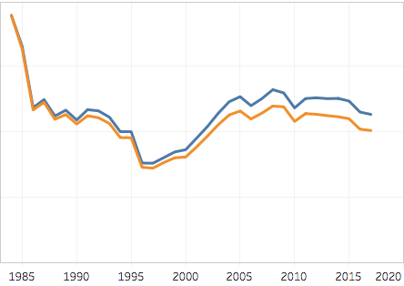
INTRODUCTION
Environmental Protection Agency
How do Vehicle Types, Manufacturers, and Technical Specs drive fuel economy and annual fuel costs?
Combined fuel economy (Combined MPG): weighted average of City and Highway MPG.
Estimated Annual Fuel Cost: based on annual mileage of 15,000 miles and projected gas prices.
Notes:
Combined MPG assumes we drive 55% in city and 45% on highway.
Negative correlation between fuel economy and cost so chose to focus on cost and CO2
Graph shows trend over time for:
Annual fuel cost in blue.
Tailpipe CO2 grams/mile in orange.

Slide 3
HYPOTHESES
H₁ There is no significant difference in Annual Fuel Costs or Tailpipe CO2 emissions between Compact and Midsize cars.
H₂ There is no significant difference in Annual Fuel Costs or Tailpipe CO2 emissions between regular and premium gas.

Slide 4
DATA
38,000 records from years 1984 to 2017 covering 133 unique car makes
Data includes manufacturer information as well as vehicle types, technical specs and EPA ratings for Fuel Economy and CO2 emissions.
Descriptive Statistics confirm normal distribution for Combined MPG, Annual Fuel Cost, and Tailpipe CO2 emissions.
There is a positive correlation with Annual Consumption of Barrels/Tailpipe CO2 and Combined MPG/Annual Fuel Cost

Slide 5
METHOD
Confirmed normal distribution using Descriptive Statistics
Split data into sample populations using pivot table filters
Used Analysis Toolpak’s Two-Sample t-Test Assuming Unequal Variances
Created an Excel Dashboard
Used Tableau for Data Visualization
Notes:
3. to look for statistical significance in populations for H₁ and H₂.
4. to compare care makes and their Annual Fuel Costs and Tailpipe CO2 emissions.

Slide 6
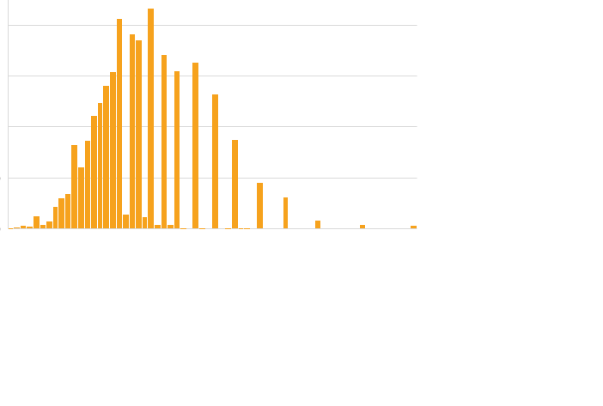

DISTRIBUTION: REGULAR AND PREMIUM GAS

Slide 7




DISTRIBUTION: COMPACT AND MIDSIZE VEHICLES

Slide 8
RESULTS

Slide 9
COMPACT VS MIDSIZE
There is significant difference between Compact and Midsize vehicles.
With 95% confidence, a Midsize vehicles cost between $168.5 and $212 more annually than compact cars.
Notes:
Compact Observations: 5,508
Midsize Observations: 4,395
P-value - 1.51947E-64

Slide 10
COMPACT VS MIDSIZE
There is significant difference between Compact and Midsize vehicles.
With 95% confidence, Midsize vehicles emit between 37.7g/m and 46.5g/p more Tailpipe CO2 than compact cars.
Notes:
Compact Observations: 5,508
Midsize Observations: 4,395
P- Value - 7.6258E-77

Slide 11
REGULAR VS PREMIUM
There is significant difference between Regular and Premium gas
With 95% confidence Vehicles using Premium gas emit between 8g/m and 13.2g/m more CO2 than Vehicles using regular gas.
Notes:
Regular Gas Observations: 25,258
Premium Gas Observations: 10,133
P-Value - 1.35115E-15

Slide 12
POTENTIAL IMPACT
Tailpipe CO2 emissions could be between 165,848.2 g/m and 204,579.3 higher in total if Midsize Vehicles were purchased over Compact Vehicles.
Tailpipe CO2 emissions could be between 81,335.4 g/m and 134,159.4 g/m in total if Premium Gas was used over Regular Gas in Vehicles.

Slide 13
RECOMMENDATIONS
Drive Compact Vehicles to save money on Annual Fuel Cost
Drive Compact Vehicles to reduce Tailpipe CO2
Drive Vehicles that do not require premium gas to reduce Tailpipe CO2

Slide 14
OTHER RESOURCES
Click to use the Vehicle Make Comparison Excel Dashboard Here
Click to see EPA Fuel Economy Dashboard in Tableau Here

Slide 15
QUESTIONS

